Slide 1
Overview of Storage and Indexing
Notes:
1
The slides for this text are organized into chapters. This lecture covers Chapter 8.
Chapter 1: Introduction to Database Systems
Chapter 2: The Entity-Relationship Model
Chapter 3: The Relational Model
Chapter 4 (Part A): Relational Algebra
Chapter 4 (Part B): Relational Calculus
Chapter 5: SQL: Queries, Programming, Triggers
Chapter 6: Query-by-Example (QBE)
Chapter 7: Storing Data: Disks and Files
Chapter 8: File Organizations and Indexing
Chapter 9: Tree-Structured Indexing
Chapter 10: Hash-Based Indexing
Chapter 11: External Sorting
Chapter 12 (Part A): Evaluation of Relational Operators
Chapter 12 (Part B): Evaluation of Relational Operators: Other Techniques
Chapter 13: Introduction to Query Optimization
Chapter 14: A Typical Relational Optimizer
Chapter 15: Schema Refinement and Normal Forms
Chapter 16 (Part A): Physical Database Design
Chapter 16 (Part B): Database Tuning
Chapter 17: Security
Chapter 18: Transaction Management Overview
Chapter 19: Concurrency Control
Chapter 20: Crash Recovery
Chapter 21: Parallel and Distributed Databases
Chapter 22: Internet Databases
Chapter 23: Decision Support
Chapter 24: Data Mining
Chapter 25: Object-Database Systems
Chapter 26: Spatial Data Management
Chapter 27: Deductive Databases
Chapter 28: Additional Topics

Slide 2
Data on External Storage
Disks: Can retrieve random page at fixed cost
But reading several consecutive pages is much cheaper than reading them in random order
Tapes: Can only read pages in sequence
Cheaper than disks; used for archival storage
File organization: Method of arranging a file of records on external storage.
Record id (rid) is sufficient to physically locate record
Indexes are data structures that allow us to find the record ids of records with given values in index search key fields
Buffer Manager: stages pages from external storage to main memory buffer pool. File and index layers make calls to the buffer manager.
record
key
File/Index
Record
ID
Record
Buffer Manager
StorageManager

Slide 3
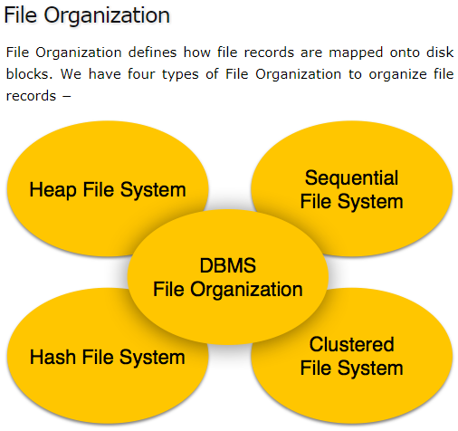

Slide 4
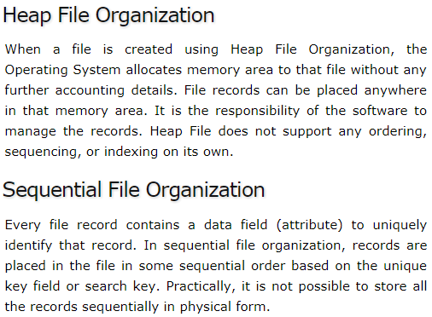

Slide 5
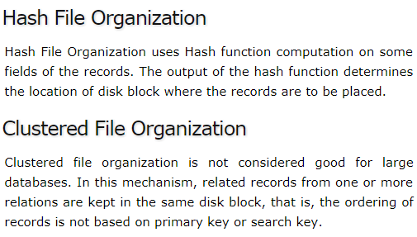

Slide 6
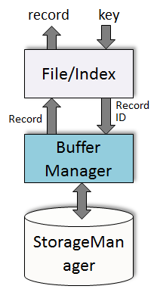
Alternative File Organizations
Many alternatives exist, each ideal for some situations, and not so good in others:
Heap (random order) files: Suitable when typical access is a file scan retrieving all records.
Sorted Files: Best if records must be retrieved in some order, or only a `range’ of records is needed.
Indexes: Data structures to organize records via trees or hashing.
Like sorted files, they speed up searches for a subset of records, based on values in certain (“search key”) fields
Updates are much faster than in sorted files.
Notes:
2

Slide 7
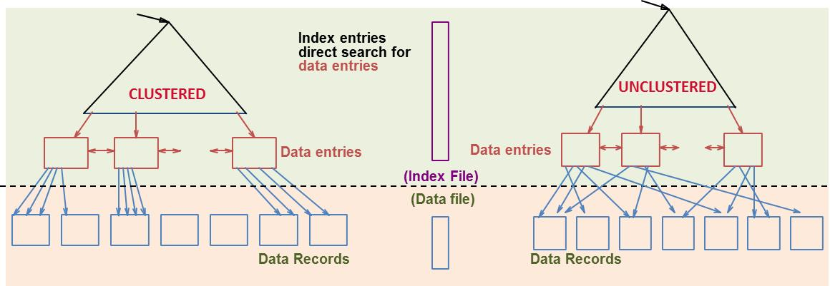
Index Classification
Primary vs. secondary: If search key contains primary key, then called primary index (alternative 1 is usually used to avoid one more I/O to bring in the matching data record).
Unique index: Search key contains a candidate key.
Clustered vs. unclustered: If order of data records is the same as, or `close to’, order of data entries, then called clustered index.
Cost of retrieving data records through index varies greatly based on whether index is clustered or not!
Notes:
11

Slide 8
Cost Model for Our Analysis
We ignore CPU costs, for simplicity:
Measuring number of page I/O’s ignores gains of pre-fetching a sequence of pages; thus, even I/O cost is only approximated.
Average-case analysis; based on several simplistic assumptions.
Average time to read/write disk page
D
R
B
Number of data pages
Number of records per page
Good enough to show the overall trends!
Notes:
3

Slide 9
Operations to Compare
Scan: Fetch all records from disk
Equality search
Range selection
Insert a record
Delete a record
Scan
Selection
Insert
Search
Delete

Slide 10
Cost of Operations
D
Several assumptions underlie these (rough) estimates!
R
B
 | Scan | Equality | Range | Insert | Delete
Heap | BD | 0.5BD | BD | 2D | Search + D
Sorted | BD | D⋅log₂B | D(log₂B + # matching pages) | Search + BD | Search + BD
Clustered | 1.5BD | D⋅log_{F}1.5B | D⋅log_{F}1.5B + # matching pages | Search + D | Search + D
Unclustered Tree Index | BD(R+0.15) | D(1 + log_{F}0.15B) | D⋅(log_{F}0.15B + # matches) | D(3 + log_{F}0.15B) | Search + 2D
Unclustered Hash Index | BD(R+0.125) | 2D | D(0.125B + # matches) | 4D | 4D
Notes:
5

